Slide 1
CS504-Software Engineering – I
VU
Lecture No. 16
Derivation of the Object Model – The Coad Methodology
An object model of a system captures the static structure of a system by showing the objects in the systems, their relationships, their attributes, and their services. To stream line the derivation of the object model, Peter Coad has divided the process into 5 activities, each being further subdivided into a number of steps. Following is the description of these activities.
Select Objects – who am I?
We have used an approach that divides the objects into different categories to make it easier to find them and establish their attributes, services, and collaborations. This activity, consisting of 6 steps, can help you find objects and categorize them. These steps are:
Select actors
Actors are people and organizations that take part in the system under consideration. Examples of actors are: person, organization (agency, company, corporation, foundation). Note that we are talking about actors and not their “roles”. e.g. a customer is a role that a person plays, so if we have a customer in our problem domain, we will also add a person as actor in the model.
Select Participants
A participant is a role that each actor plays in the system under consideration. Examples of participants are: agent, applicant, buyer, cashier, clerk, customer, dealer, distributor, donor, employee, investor, member, officer, owner, policy holder, recipient, student, supervisor, supplier, teacher, worker. It may be noted that the same person may play different roles at different times in the system. That means that if we model this behavior using Generalization-Specialization instead of Actor-Participant, we may end up with multiple inheritance.
Select Places
Places are where things come to rest or places that contain other objects. Examples of places are: airport, assembly-line, bank, city, clinic, country, depot, garage, hanger, hospital, plant, region, sales outlet, service center, shelf, station, store, warehouse, zone.
Select Transactions
Transactions are the “events” that must be remembered through time. These are entries that must be maintained in a historical record or log which may be used to answer questions or perform assessments. These transactions usually come from a window (GUI), some object which monitors for significant event and logs that information, or a another system that interacts with the system under consideration and logs some

Slide 2
CS504-Software Engineering – I VU
information. Examples of transactions are: agreement, assignment, authorization, contract, delivery, deposit, incident, inquiry, order, payment, problem report, purchase, refund, registration, rental, reservation, sale, shift, shipment, subscription, withdrawal. Note that nearly all transactions consist of a number of transaction line items.
Select Container Objects
Containers are objects that hold other objects. Note the similarity of definition between container and places. The difference is that a place is a place in the literal sense while a container is a any object that can hold other objects, e.g. bin, box, cabinet, folder, locker, safe, shelf, etc. Therefore a place is also a container but every container need not be a place.
Select Tangible things
Take a “walk” through the system and select “tangible” things around you used in the problem domain. These may be characterized as all the remaining (not yet selected) “nouns” that make up the problem domain. Examples are: account, book, calendar, cash box, cash drawer, item, plan, procedure, product, schedule, skill, tool, etc.
While selecting objects, the following considerations should be kept in mind for a simpler (and better) object model.
Every object that you put in your object model should have some responsibility or role to play in the problem domain. You need to know each object, its attributes, and services. If there is no way to know about the object, remove it from the object model.
Avoid having controller objects because controllers usually end up with functionality that’s better done by other objects themselves, making the message passing more complicated, and resulting in higher coupling. Use delegation instead. Note the difference between controlling and delegation; a controller wants to do every thing by himself (doesn’t trust anyone), while a good manager delegates responsibility (and takes credit).
In large systems several objects are likely to have similar or even identical responsibilities. Look for such objects and seek a common name to simplify the object model.
Use meaningful class names, names that describe objects in that class. Try to use names from the domain vocabulary to avoid confusion.

Slide 3
CS504-Software Engineering – I
VU
Lecture No. 17
Identify Structures
A structure is a manner of organization which expresses a organization within the problem domain. There are two Generalization-Specialization (Gen-Spec) and whole-part. This identification of these structures in the following 2 steps:
semantically strong type of structures: activity covers the
Identify Gen-Spec Structures (Hierarchy)
Consider each class that you have identified as a specialization and then look for its generalization and vice versa.
Identify Whole-Part structures (Aggregations) - What are my components?
For each object that you have identified, consider it as a whole and then try to find out its parts - objects that make up this object.
Define Attributes - What I Know?
The first two activities would identify most of the objects (classes) in the problem domain. Now is the time to think about the role and responsibilities of these objects. The first thing to consider is their attributes, i.e., what it knows.
For each object include the attributes that come to mind when you first think about the object. The criteria for the inclusion of an attribute is that it should be included if the system needs to know its value and it cannot get it any other way. Don not add an attribute for an association or aggregation. Examples of attributes are: number, name, address, date, time, operational state, phone, status, threshold, type, etc. In particular, consider the following attributes for different types of objects.
For actors consider name, address, phone.
For participants consider number, date and time, password, authorization level.
For place/location consider number, name, address (perhaps latitude, longitude, altitude).
For transaction consider number, date, time, status.
For line item consider quantity, status.
For item consider name, description, dimension, size, UPC, weight.
Like object selection, there are a number of issues that every designer must be aware of while defining attributes of an object. These are:
An attribute that varies over time, e.g., price of an item, should be replaced by an additional class with an effective date and value.
An attribute that may have a number of values should be replaced by a new class and
an object connection.
Replace “yes/no” type attributes with “status” type attributes for flexibility.
If there are classes with common attributes and generalization-specialization makes good sense, then add a generalization class and factor out the commonality.

Slide 4
CS504-Software Engineering – I
VU
Show Collaborations (associations and aggregations) - Who I know?
The second step in establishing each object’s responsibility is to identify and show how this object collaborates with other objects, i.e., who it knows. These collaborations can be identified with the help of the following 8 steps:
For an actor, include an object connect to its participants (association).
For a participant, include an object connection to its actor (already established) and its transactions (association).
For a location, include object connections to objects that it can hold (association), to its part objects (aggregation), and to the transactions that are taking place at that location (association).
For transactions, include object connections to its participants (already established), its line items (aggregation), and its immediate subsequent transaction (aggregation).
For a transaction line item, include object connections to its transaction (already established), its item (association), a companion “item description” object (association), and a subsequent line item (association).
For an item, include object connections to transaction line item (already established),
a companion “item description” object (association).
For a composite object, include object connections to its “part” object (aggregation).
For all objects (including all of the above) select connecting objects to which the object under consideration sends a message (within one or more scenarios) to get some information or to answer a query about objects directly related to it (association).
Define Services - What I do?
The third and last step in establishing each object’s responsibility is to define what services does each object in the problem domain provide, i.e., what it does. Putting the right service with the right object is also very important since any mistake in judgment will increase coupling and reduce cohesion. The verbs in your problem domain usually indicate some of the services required of the associated object.
Software objects do things that the system is responsible to do with regard to that object. By putting the services with the attributes they work on results in lower coupling and stronger cohesion, and increased likelihood of reuse. The basic principle is to keep data and action together for lower coupling and better cohesion. The basic services, done by all (such as get, set, create, initialize), are not shown in the object model. While establishing the services for an object, the following fundamental questions should be asked:
Why does the system need this object any way?
What useful questions can it answer?
What useful action can it perform?
What this object can do, based upon what it knows?
What this object can do, based upon whom it knows?

Slide 5
CS504-Software Engineering – I
VU
What calculations can it do?
What ongoing monitoring could it do?
What calculations across a collection could it make (letting each worker do its part)?
What selections across a collection could it make (letting each worker do its part)?
While establishing services of certain specific types of objects, the following should be considered:
For an actor, consider: calculate for me, rate me, is <value>, rank participants, calculate over participants.
For a participant, consider: calculate for me, rate me, is <value>, rank transactions, calculate over transactions.
For a place, consider: calculate for me, rate me, is <value>, rank transactions, calculate over contents, calculate over container line items.
For a Transaction, consider: calculate for me, rate me, is <value>, how many, how much, rank transaction line items, rank subsequent transactions, calculate over transaction line items, calculate over subsequent transactions.
For a line item, consider: calculate for me, rate me.
For an item, consider: calculate for me, rate me, is <value>, how many, how much, rank, calculate over specific items.
Lecture No. 18
CASE STUDY: Connie’s Convenience Store - A point of Sale System
The System
Identify the purpose of the system
develop an overall purpose statement in 25 words or less. Why this system? Why now?
Keep the overall goal, the critical success factor, always before you.
“To support, to help, to facilitate, ...”
Connie’s Wish List
scan items and automatically price them
know whether an item is on sale
automatically total the sale and calculate tax
handle purcahses and returns
handle payments with cash, check, or charge
authorize checks and cards
calculate change when working with cash or checks
record all of the information about a customer transaction

Slide 6
CS504-Software Engineering – I
VU
balance the cash in the drawer with the amount recorded by the point-of-sale system.
Why ?
speed up checkout time
reduce the number of pricing errors
reduce the labour required to ticket the item with a price, originally and when prices change.
Summary
to help each cashier work more effectively during checkout, to keep good records of each sale, and to store more efficient store operations.
Identify system features
Be certain to include features that cover the following
log important information
conduct business
analyze business results
interact with other systems
Identify features for logging important information
to maintain prices based upon UPC
to maintain tax categories (categories, rates, and effective dates)
to maintain the authorized cashiers
to maintain what items we sell in a store
to log the results of each sale in a store
Identify features for conducting business
to price each item, based upon its UPC
to subtotal, calculate tax, and total
to accept payment by cash, check, or charge
Identify features for analyzing business results
to count how many of each item sold
to count how much we received in cash, check, or credit card sales
to assess how each cashier is performing
to assess how each store is performing
Identify features for working with interacting systems
to obtain authorization from one or more credit (or check) authorization system

Slide 7
CS504-Software Engineering – I
VU
SELECTING OBJECTS
Select Actors
the actor is:
person
Select Participants
the Participants are:
cashier
head cashier
customer
Cashier and Head Cashier
Is there a difference between head cashier and cashier in terms of their behavior and knowledge?. If no then we don not need a separate class for head cashier.
Customer
customer. You must have a way to know about customer objects; otherwise it should not be put in the domain model.
Select Places
The places are:
store
shelf
Shelf
The system does not keep track of the shelves.
Select Transactions
Significant Transactions are:
sale
every sale is a collection of sale line items
return
payment
session
Select Container Classes
The store is a container class. a store contains
cashiers
registers
items
Select Tangible Things
Tangible things in store:

Slide 8
CS504-Software Engineering – I
VU
item
register
cash drawer
Tax Category (Descriptive things)
Session
Is it important? It is important in order to evaluate a cashier’s performance.
Lecture No. 19
Identify Structures
Identify Gen-Spec Structures
Kinds of stores:
A store is a kind of sales outlet. Perhaps over time, Connie will expand to other kinds of sales outlets. Stores might be specialized into kinds of stores. For now on leave store as it is.
Kinds of sales:
sales, returns
only different is that the amount is positive or negative. Is there any other difference?
Prices:
regular price, and promotional (sales) price
Payment:
cash, check, and charge are kind of payments
Identify Whole-Part Structures
A store as a whole is made up of cashiers, registers, and items.
A register contains a cash drawer.
A sale is constituted of sale line items.
100
© Copyright Virtual University of Pakistan

Slide 9
CS504-Software Engineering – I
VU
Payment
Price
Cheque
Charge
Cash Payment
Promotional Price
Object Hierarchy
Stote
Sale
Register
Cashier
Item
Sales Line Item
Cash Drawer
Whole-Part Structures
Establishing Responsibilities
Who I Know - Rules of Thumb
an actor knows about its participants person knows about cashier
a transaction knows about its participants
a session knows about its register and cashier
A transaction contains its transaction line items sale contains its sales line items

Slide 10
CS504-Software Engineering – I
VU
A transaction knows its sub transactions session knows about its sales
sale knows about its payments
A place knows about its transactions store knows about its sessions
A place knows about its descriptive objects store knows about its tax categories
A container knows about its contents
a store knows about its cashiers, items, and registers
Person
Store
Tax Category
Cashier
Session
Register
Payment
Sales
Association Relationships
Define Attributes, Services, and Links - What I know, What I do, and Who I know?
Actors:
person
Attributes: Services:
name, address, phone
eating, walking
Participants:
cashier
Attributes: Services:
number, password, authorization level, current session isAuthorized, assess Performance
Places:
store
Attributes: Services:
name
get item for UPC, get cashier for number

Slide 11
CS504-Software Engineering – I
VU
Tangible things:
item
Attributes:
number, description, UPCs, prices, taxable
attributes with repeating names - create new objects UPC, Price (specialization - promotional price)
get price for a date, how much for quantity
Services:
Who I Know? UPC, Price, tax category, sale line item
register
Attributes: Services:
number
how much over interval, how many over interval
Who I know? store, session, cash drawer (part of register)
cash drawer
Attributes: Services:
balance, position (open, close), operational state open
Who I know? register
Tax Category
Attributes: Services:
category, rate, effective date
just the basic services - get, add, set - don’t show
Who I know? items?
Transactions:
sale
Attributes: Services: calculate
date and time
calculate subtotal, calculate total, calculate
discount,
tax, commit
Who I Know? session, payment, SLIs
sale line item
Attributes: exempt) Services:
date and time ?, quantity, tax status ( regular, resale, tax-
calculate sub total
Who I Know? item, sale
sale line item - how do you handle returns and sales sale - you have control
return - more difficult
return to a different store
purchased for a different price
returns an item no longer in the inventory
return
Attributes:
return price, reason code, sale date, sale price

Slide 12
CS504-Software Engineering – I
VU
Services: Who I Know?
is it a case for gen-spec, what’s same, what’s different payment - we have types of payments
Attributes:
each payment knows about its amount paid, cash tendered
a check object knows its
bank, account number, amount tendered, authorization code a credit object knows about its
card type, card number, expiration date, authorization code common attributes among check and credit - use gen-spec hierarchy becomes:
payment
cash payment authorized payment
check card
Services:
who I know: sale
Payment
Sales Line Item
Authorized Payment
Cash Payment
Return Line Item
Cheque
Charge
session
Attributes: Services:
start date, end date, start time, end time
how much money collected over interval, how many sales

Slide 13
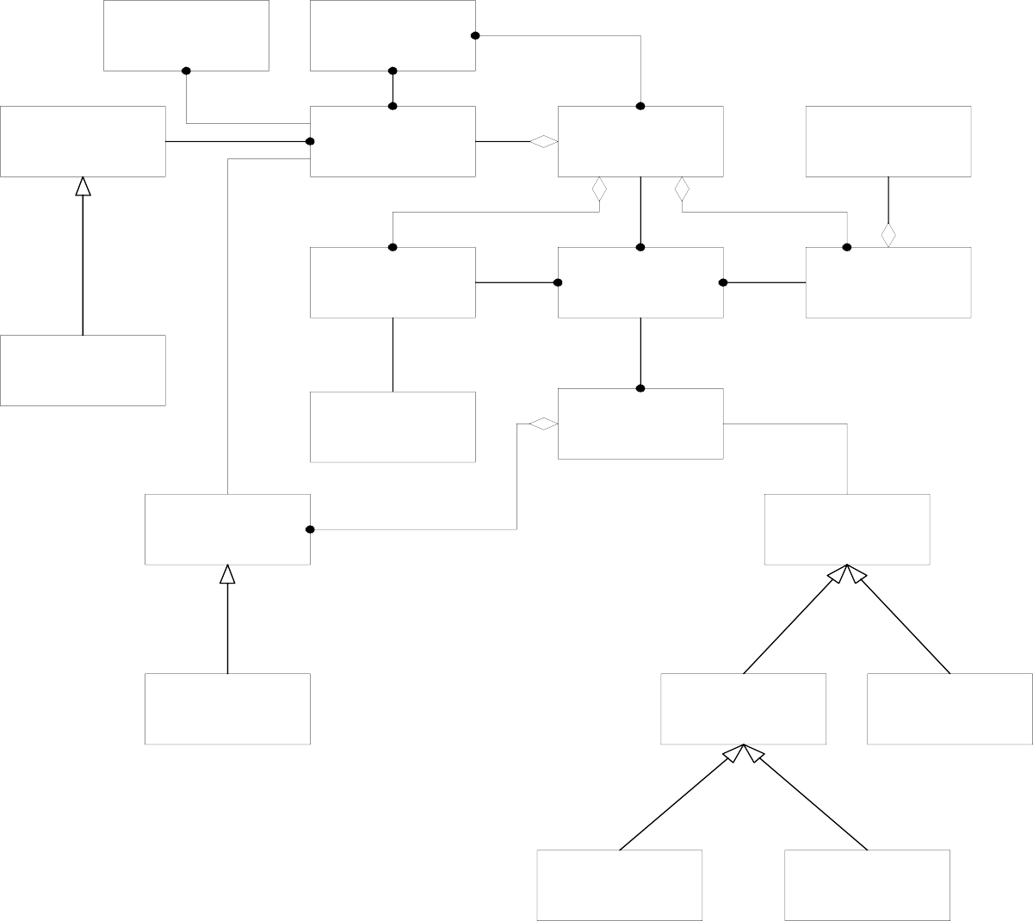
CS504-Software Engineering – I
VU
Who I know? register, cashier, store, sales
UPCs
Tax Category
Price
Item
Store
Cash Drawer
Cashier
Session
Register
Promotional Price
Person
Sale
Sales Line Item
Payment
Return Line Item
Authorized Payment
Cash Payment
Cheque
Charge
Object Model Diagram for Connie’s Convenience Store

Slide 14
CS504-Software Engineering – I VU
Lecture No. 20
Interaction Diagrams – depicting the dynamic behaviour of the system
A series of diagrams can be used to describe the dynamic behavior of an object-oriented system. This is done in terms of a set of messages exchanged among a set of objects within a context to accomplish a purpose. This is often used to model the way a use case is realized through a sequence of messages between objects.
The purpose of Interaction diagrams is to:
Model interactions between objects
Assist in understanding how a system (a use case) actually works
Verify that a use case description can be supported by the existing classes
Identify responsibilities/operations and assign them to classes
UML provides two different mechanisms to document the dynamic behaviour of the system. These are sequence diagrams which provide a time-based view and Collaboration Diagrams which provide an organization-based view of the system’s dynamics.
The Sequence Diagram
Let us first look at Sequence Diagrams. These diagrams illustrate how objects interacts with each other and emphasize time ordering of messages by showing object interactions arranged in time sequence. These can be used to model simple sequential flow, branching, iteration, recursion and concurrency. The focus of sequence diagrams is on objects (and classes) and message exchanges among them to carry out the scenarios functionality. The objects are organized in a horizontal line and the events in a vertical time line.
The Notation
Following diagram illustrates the notation used for drawing sequence diagrams.
: Professor CourseManager
Math 101 - Section
1 : CourseOffering
Add professor (Professor)
Lifeline
Message

Slide 15
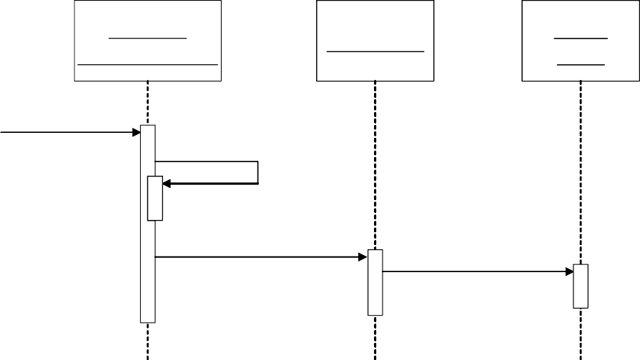
CS504-Software Engineering – I
VU
The boxes denote objects (or classes), the solid lines depict messages being sent from one object to the other in the direction of the arrow, and the dotted lines are called life-lines of objects. The life line represents the object’s life during interaction. We will discuss this in more detail later.
These concepts are further elaborated with the help of the following sequence diagram.
X-Axis (objects)
member: LibraryMember
book:Book
:Book Copy
borrow(book)
Life Line
Object
Y-Axis (time)
message
ok = mayBorrow()
[ok] borrow(member)
Activation box
setTaken(member)
condition
As shown above, in a sequence diagram, objects (and classes) are arranged on the X-Axis (horizontally) while time is shown on the Y-Axis (vertically). The boxes on the life-line are called activation boxes and show for how long a particular message will be active, from its start to finish. We can also show if a particular condition needs to occur before a message is invoked simply by putting the condition in a box before the message. For example, object member:LibraryMember sends a message to object book:book if the value of ok is true.
The syntax used for naming objects in a sequence diagram is as follows:
syntax: [instanceName][:className]
Name classes consistently with your class diagram (same classes).
Include instance names when objects are referred to in messages or when several objects of the same type exist in the diagram.
An interaction between two objects is performed as a message sent from one object to another. It is most often implemented by a simple operation call. It can however be an

